Slide 1
CS842 Project Presentation on
Sentiment Instigate Pair Extraction (SIPE)
Krishna Patel (200441475) and Sushitha Rajeeva(200425621)
Department of Computer Science
Professor : Dr. Alireza Manashty
APRIL 12 , 2021

Slide 2
Outline
Introduction
Problem Statement
Implementation
Solution Overview
Results
Challenges
Future Work
References
02 of 22

Slide 3

Introduction
Fig 1 : Overall Project
03 of 22

Slide 4
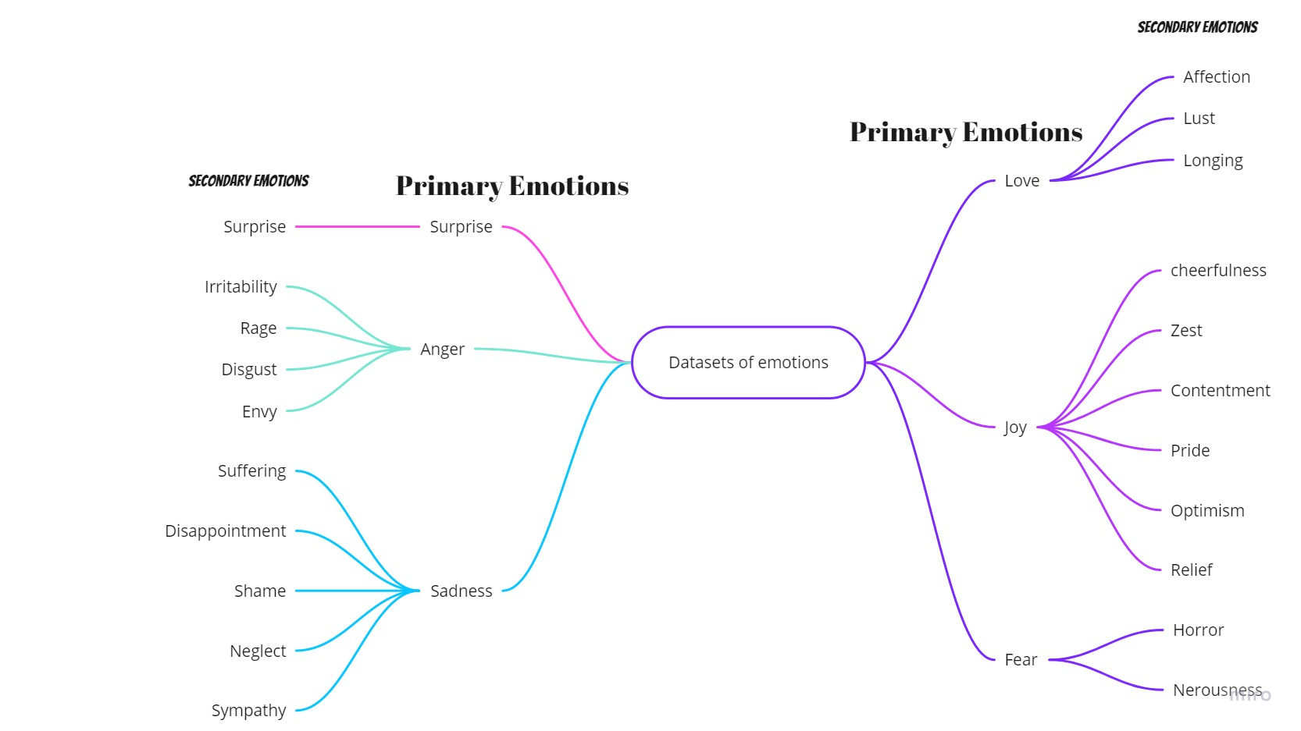
Introduction
Analyzing emotions from any of generated styles of text like paragraphs, reviews, etc
Sentiment Analysis is the most popular tool in Natural Language Processing (NLP)
Opinion Mining aims to determine attitude of speaker in some area or overall polarity of document
Fig 2 : Emotion Graph
04 of 22

Slide 5
Problem Statement
Prediction of next sentence due to huge datasets
Analyzing how well user is satisfied with service or related area of feedback
Understanding the feedback of customers
Approach
Emotion Classification
Web application
05 of 22

Slide 6
Problem Statement …..
Approach
Emotion Classification :
BERT Model
Bi-LSTM Model
Naïve Bayes
Web application
Input : Review / Feedback
Output : Probability of review in emotion polarity class
Logistic Regression
Random Forest
Linear Support Vector
06 of 22

Slide 7
Implementation
Steps
Data Selection
- Text Emotion Master
Data Preprocessing
Data Transformation
Data Extraction
Training the Models
07 of 22

Slide 8
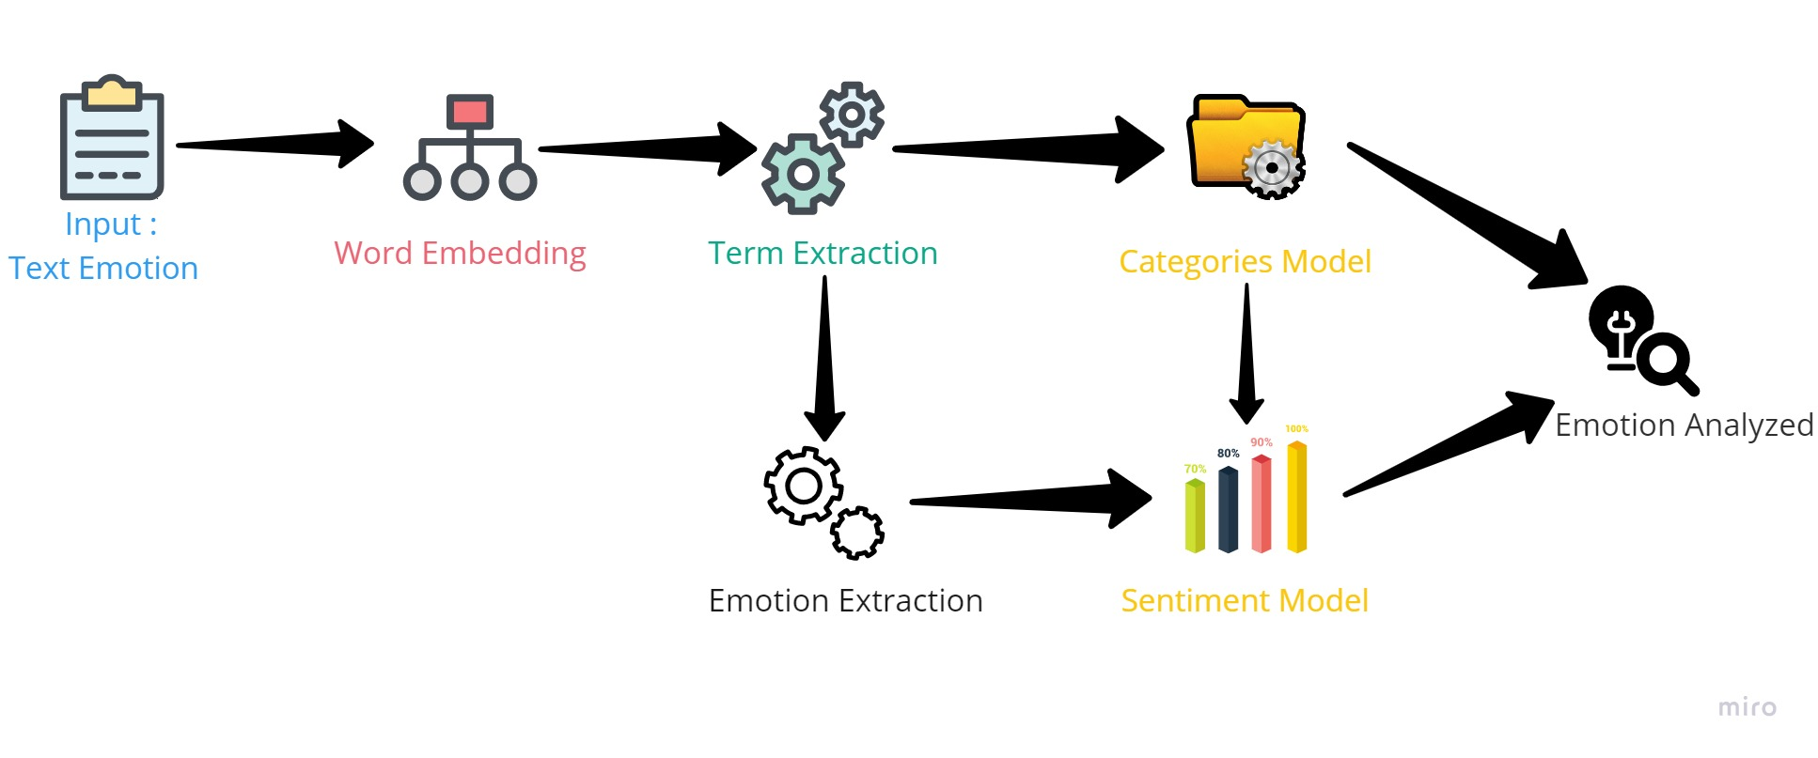
Implementation….
Fig 3 : High Level Diagram
08 of 22

Slide 9
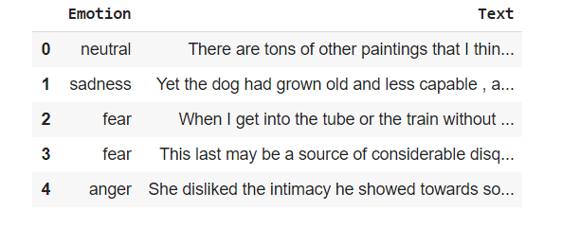
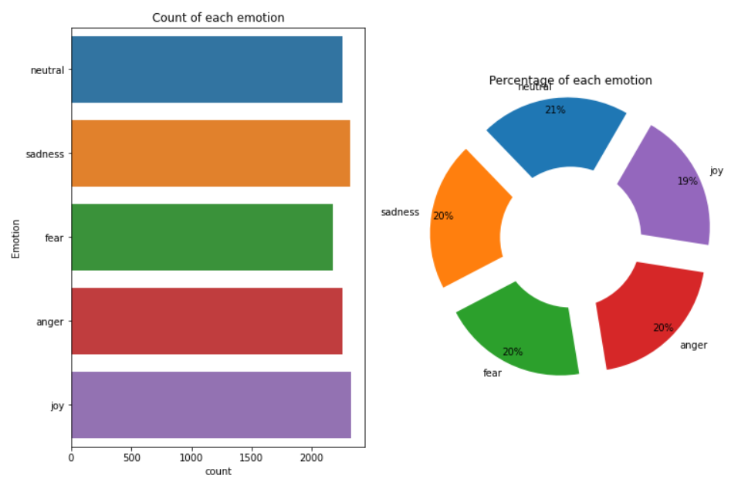
Data Selection
Customer Reviews
Customer review dataset
More than 10000 records
Two Columns
- Emotion
- Text
Fig 4 : Sample dataset
Fig 5 : Count of Emotion
09 of 22

Slide 10
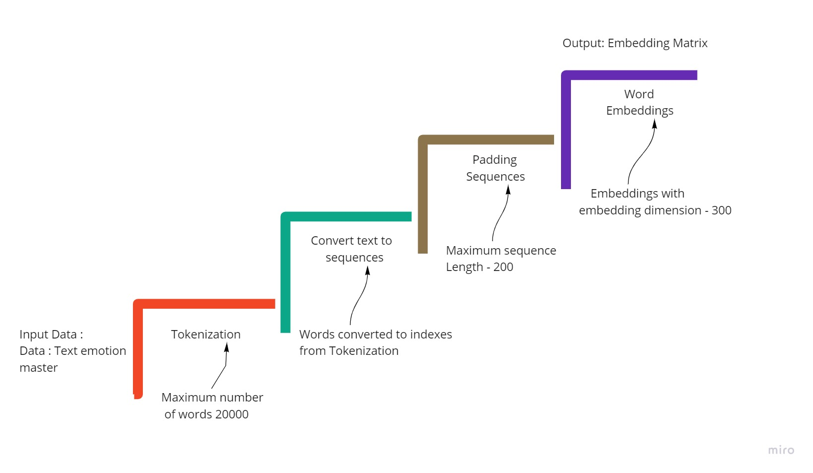
Data Preprocessing
Eliminate Missing and Numeric data
Eliminate Noisy data
a. All non-alpha characters
Case conversion
Tokenization
Stopwords Removal
Stemming
Fig 6 : Steps of Preprocessing
10 of 22

Slide 11
Data Transformation
BERT Model
Used Pre-trained BERT Model
LSTM Model
Tokenize text and count unique tokens
Padding : Each input (Sentence or text) has to be of the same Length
Labels have to be converted to integers and Categorized.
11 of 22

Slide 12
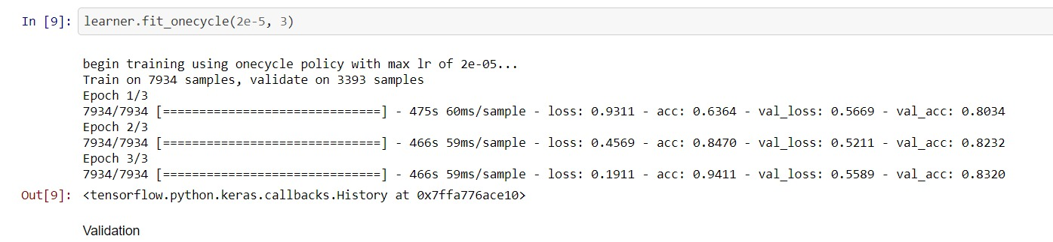
Training the Model
1. Use of BERT model
Fig 7 : Training of BERT Model
12 of 22

Slide 13
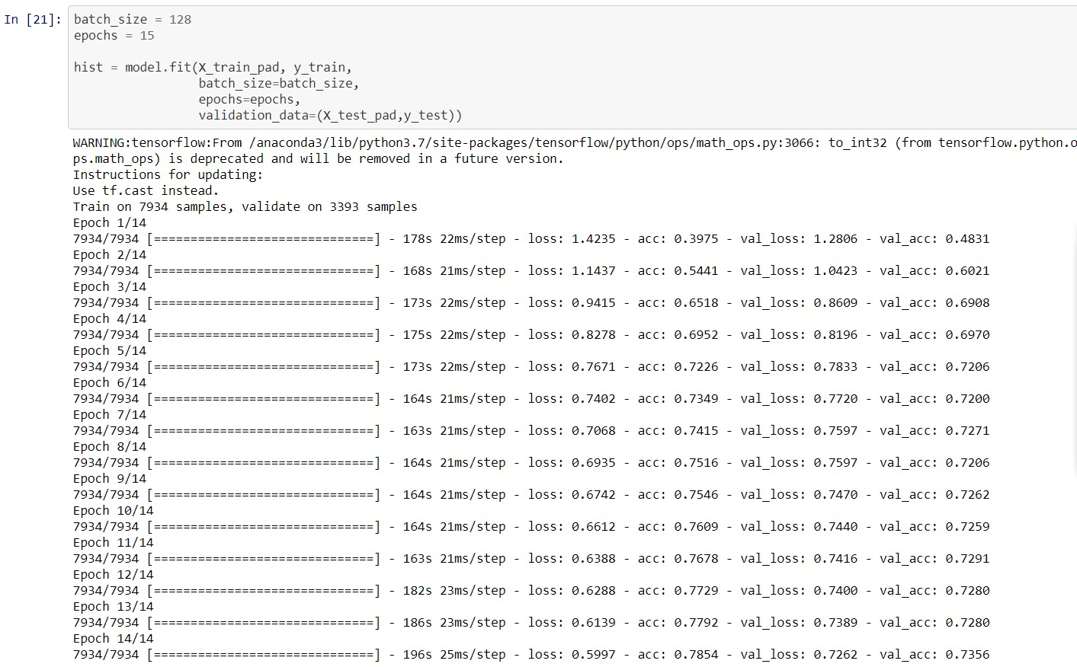
Training the Model
2. Use of Bi-LSTM model
Fig 7 : Training of Bi-LSTM Model
13 of 22

Slide 14
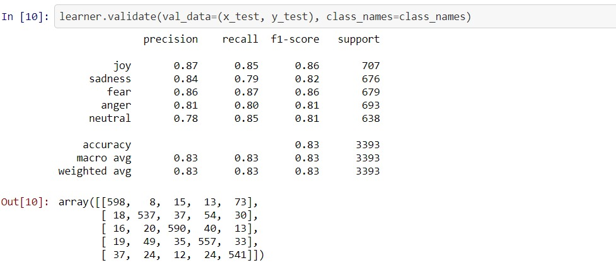
Solution Overview
1. Use of BERT model
Fig 9 : Performance of BERT Model
14 of 22

Slide 15
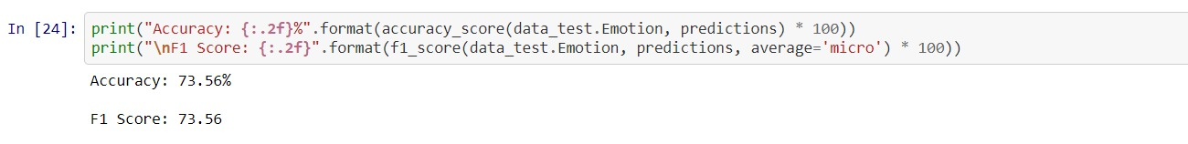
Solution Overview
2. Use of Bi-LSTM model
Fig 10 : Performance of Bi-LSTM Model
15 of 22

Slide 16
Solution Overview
 | Accuracy | F1-Score
BERT Model | 83.0 % | 83.0 %
Bi-LSTM Model | 73.56 % | 73.56 %
Linear Support Vector | 72.71 % | 72.71 %
Logistic Regression | 69.35 % | 69.35 %
Naïve Bayes | 67.02 % | 67.02 %
Random Forest | 63.40 % | 63.40 %
16 of 22

Slide 17
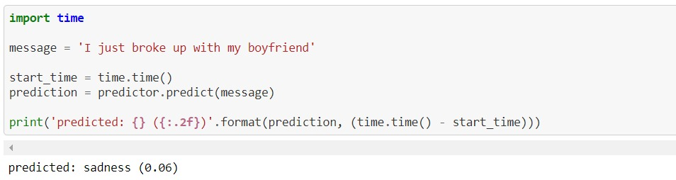
Results
Fig 11 : Model Summary
17 of 22

Slide 18
Web Application
Python Framework
BERT Model
HTML
CSS
Google Cloud Platform
18 of 22

Slide 19
Challenges
Hardware
Working on data analysis and going through all models that suits our project for accuracy
19 of 22

Slide 20
Future Work
Going ahead with other models
Work on more datasets using this models
Website more user friendly
20 of 22

Slide 21
References
R. Xia, Z. Ding, "Emotion-Cause Pair Extraction: A New Task to Emotion Analysis in Texts" in Proceedings of the 57th Annual Meeting of the Association for Computational Linguistics, 2019. pp, 1003{1012.
Z. Ding, R. Xia, J. Yu, "ECPE-2D: Emotion-Cause Pair Extraction based on Joint Two-Dimensional Representation, Interaction and Prediction“ in Proceedings of the 58th Annual Meeting of the Association for Computational Linguistics, 2020. pp, 3161{3170.
Refered for Coding : https://github.com/lukasgarbas/nlp-text-emotion
https://www.youtube.com/
https://colab.research.google.com/notebooks/
21 of 22

Slide 22
Thank You

